Slide 1

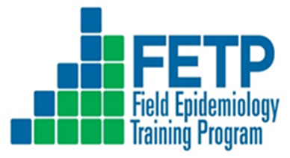





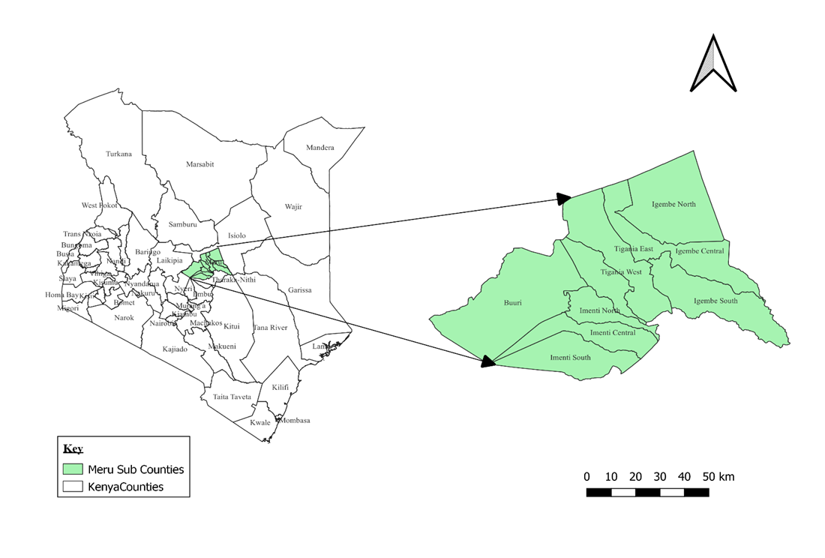
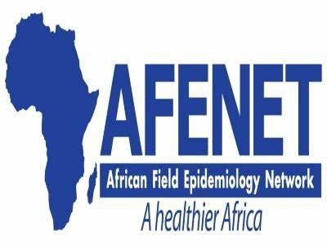
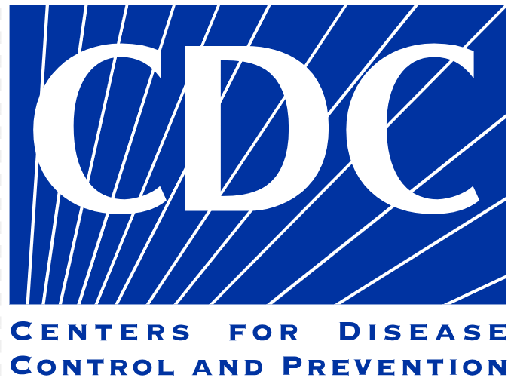

Determinants of Drug-resistant Tuberculosis in Meru County, Kenya, 2024
Abdiaziz M Mohamud¹ ,Herman Weyenga² , Lameck Diero³
¹Kenya Field Epidemiology and Laboratory Training Program, Nairobi, Kenya, ²US-Center For Disease Control and Prevention, Kenya, ³Moi University, Kenya
BACKGROUND
Tuberculosis (TB) remains a major public health burden globally
Drug-resistant Tuberculosis (DRTB) poses a significant global health challenge, with increasing incidence rates and complex patterns of resistance transmission within communities and regions
DRTB cases steadily increasing in Meru county, 4% (2019), 7.6% (2020),10.2% (2021) and 14.8% (2022) compared to those reported nationally
In 2022, Globally 10.6 million TB cases (WHO,2022)
1.3 million Deaths (WHO,2022)
Globally 410,000 drug-resistant tuberculosis (DRTB) cases (WHO,2022)
Kenya is among the 30 TB/DRTB high-burden countries in 2022
752 DRTB cases, (DNTLP report,2022)
Meru County had the highest DRTB burden in Kenya, with 111 DRTB cases (14.8%) of total cases (DNLTP report,2022)
OBJECTIVE: To determine sociodemographic, clinical, behavioural and socioeconomic factors associated with drug-resistant tuberculosis in Meru County, Kenya
METHODOLOGY: A case-control study was conducted among patients with TB in Meru County
Participants were interviewed using a structured questionnaire. Information collected: sociodemographic, clinical, Behavioural and socioeconomic factors
Cases were defined as patients resistant to at least one first-line anti-TB drug
Controls were bacteriologically confirmed TB patients who achieved sputum smear conversion (cured) at months 2, 5, and 6
Calculated descriptive statistics, Crude odds ratio was used to measure association in bivariate analysis and in Multivariate model a p-value of <0.05 was considered significant
Figure 1: Study area , map of Meru County
Table 2: Determinants of drug resistant tuberculosis in Meru County
RESULTS
Variable | Cases n=83 (%) | Controls n=166 (%) | Adjusted odds ratio (95% CI) | p-value
Education status
No formal education | 29 (34.1) | 24 (14.5) | 3.37 (1.02-11.18) | 0.047
Primary | 39 (47) | 66 (39.8) | 1.89 (0.61-5.81) | 0.268
Secondary | 10 (12) | 51 (30.7) | 0.96 (0.27-3.37) | 0.949
Tertiary | 5 (6) | 25 (15.1) | Reference
Contact with DRTB
Yes | 17 (20.5) | 12 (7.2) | 3.92 (1.54-9.95) | 0.004
No | 66 (79.5) | 154 (97.8) | Reference
Heard of DRTB
No | 57 (68.7) | 50 (30.1) | 3.49 (1.87-6.52) | <0.001
Yes | 26 (31.3) | 116 (69.9) | Reference
Alcohol consumption
Yes | 68 (81.9) | 92 (55.4) | 2.53 (1.25-5.13) | 0.010
No | 15 (18.1) | 74 (44.6) | Reference
A total of 83 cases and 166 Controls were enrolled: the mean age of cases was 39.9(±12.2) years, controls were 37.7(±13.9) years, males were 57 (68.7%) of cases and 118 (71.7%) of controls
The majority of the cases, 63 (75.9%), were mono-resistant DRTB
Determinants of DRTB were having no formal education (aOR=3.37, 95% CI 1.02–11.75), contact with DRTB cases (aOR=3.92, 95% CI 1.54–9.95), lack of awareness about DRTB (aOR=3.49, 95% CI 1.87–6.52), and alcohol consumption (aOR=2.52, 95% CI 1.25–5.13)
Table 1 Sociodemographic characteristics of cases and controls, Meru County
Variable | Cases n=83 (%) | Controls n=166 (%)
Age
Mean age | 39.9 (SD±12.2 years) | 37.7 (SD±13.9 years)
≤ 24 years | 9 (10.8) | 30 (18.1)
25–44 years | 43 (51.8) | 93 (56)
45–64 years | 28 (33.7) | 36 (21.7)
≥ 65 years | 3 (3.6) | 7 (4.2)
Gender
Male | 57 (68.7) | 118 (71.1)
Female | 26 (31.3) | 48 (28.9)
Marital status
Married | 33 (39.8) | 74 (44.6)
Single | 27 (32.5) | 57 (34.3)
Divorced | 19 (22.9) | 25 (15.1)
Widowed | 4 (4.8) | 10 (6)
Occupation
Formal employment | 3 (3.6) | 13 (7.8)
Informal employment | 59 (71.1) | 104 (62.7)
Student | 3 (3.6) | 6 (3.6)
Unemployed | 18 (21.7) | 43 (25.9)
Educational status
No formal education | 29 (34.9) | 24 (14.5)
Primary | 39 (47) | 66 (39.8)
Secondary | 10 (12) | 51 (30.7)
Tertiary | 5 (6) | 25 (15.1)
Sub County
Imenti south | 18 (22) | 36 (22)
Imenti north | 9 (11) | 18 (11)
Igembe south | 12 (14) | 24 (14)
Igembe north | 19 (23) | 38 (23)
Tigania west | 10 (12) | 20 (12)
Tigania east | 15 (18) | 30 (18)
DISCUSSION
Having no formal education was significantly associated with the development of drug-resistant tuberculosis
These individuals may lack the confidence or knowledge to seek appropriate care
Having contact with a known DRTB case was associated with the development of drug-resistant tuberculosis
Could be due to insufficient infection prevention measures
Alcohol consumption was associated with DRTB development
Alcohol users may not follow recommended TB treatment plans because they lack self-discipline
Lack of awareness about DRTB was associated with the development of drug-resistant tuberculosis
Not having any information about DRTB can expose you to it
CONCLUSIONS
Having no formal education, contact with DRTB cases, alcohol consumption, and not hearing about DRTB increases the risk of DRTB
We recommend integrating TB education into community learning initiatives, expanding awareness campaigns, strengthening contact tracing, and integrating alcohol abuse support programs into TB control efforts
Contact: [abdulsuper86@gmail.com]

